Slide 1
Ordinance on arrival

Slide 2
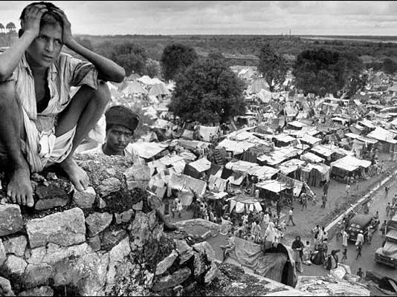
Indian refugee camp

Slide 3
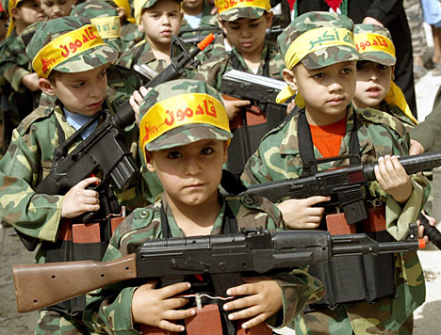
Children celebrating Nakba day in a refugee camp

Slide 4
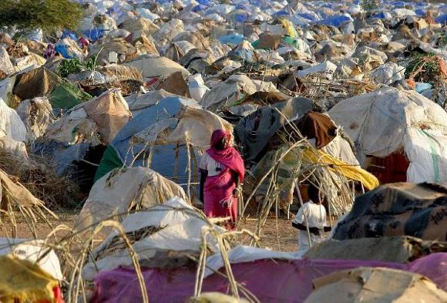
Refugee camp in Africa, One million people

Slide 5
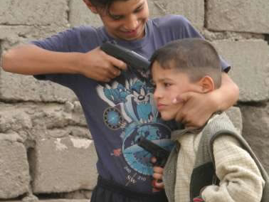
Bagdad refugee camp

Slide 6
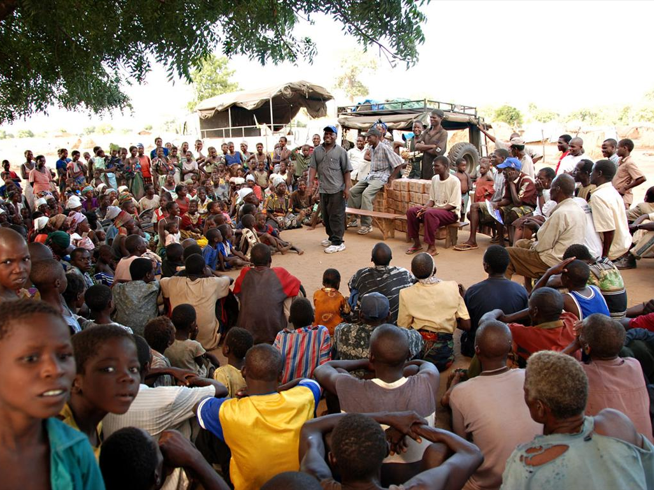
Mozambique refugee camp

Slide 7
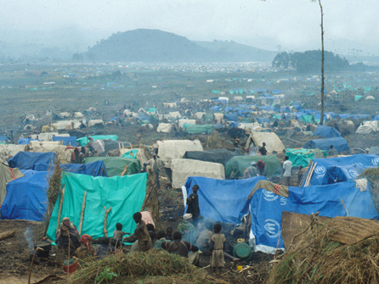
Rwandan refugee camp

Slide 8
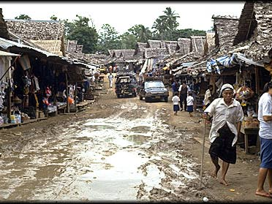
Thailand refugee camp

Slide 9
Questions: 1. Why does Nafeesa think this is a sad poem?
She is sad because people are capable of treating each other badly

Slide 10
2. Describe the journey that the refugee in the poem must have made to get to this place.
It was a terrible trip. They had no hot food or baths along the way.

Slide 11
3. What are statistics?.
Research, data collected by researchers. It refers to numbers.

Slide 12
4. What is bad about describing people using statistics?
You say people are like numbers. Meaningless. The people who died mean nothing.

Slide 13
5. What does the refugee look forward to in his new country?
A bath
A hot meal
A good night’s sleep
Medical attention
A way back to their own country when all is better

Slide 14
6. The refugee gets nothing from his new country, not even medical attention. Why not?
The country does not want them there.
It’s not their responsibility to look after the refugees.

Slide 15
7. What excuse does the official give for this?
Help has always been in short supply and now it is impossible to find.

Slide 16
8. Which of the words below best describe the attitude of the official to the refugee? Generous kind unsympathetic hostile unfeeling warm welcoming
Unsympathetic
Hostile
Unfeeling

